Slide 1
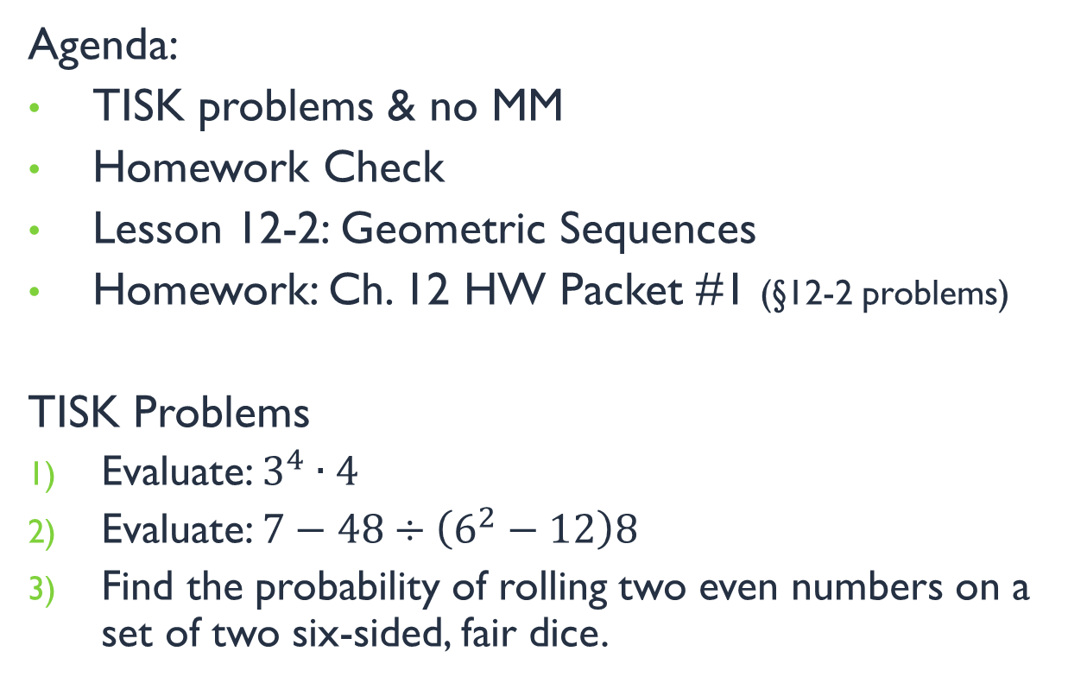
Wednesday, January 16, 2013
Agenda:
TISK problems & no MM
Homework Check
Lesson 12-2: Geometric Sequences
Homework: Ch. 12 HW Packet #1 (§12-2 problems)
TISK Problems
Evaluate: $3^{4}∙4$
Evaluate: $7−48÷\left(6^{2}−12\right)8$
Find the probability of rolling two even numbers on a set of two six-sided, fair dice.

Slide 2
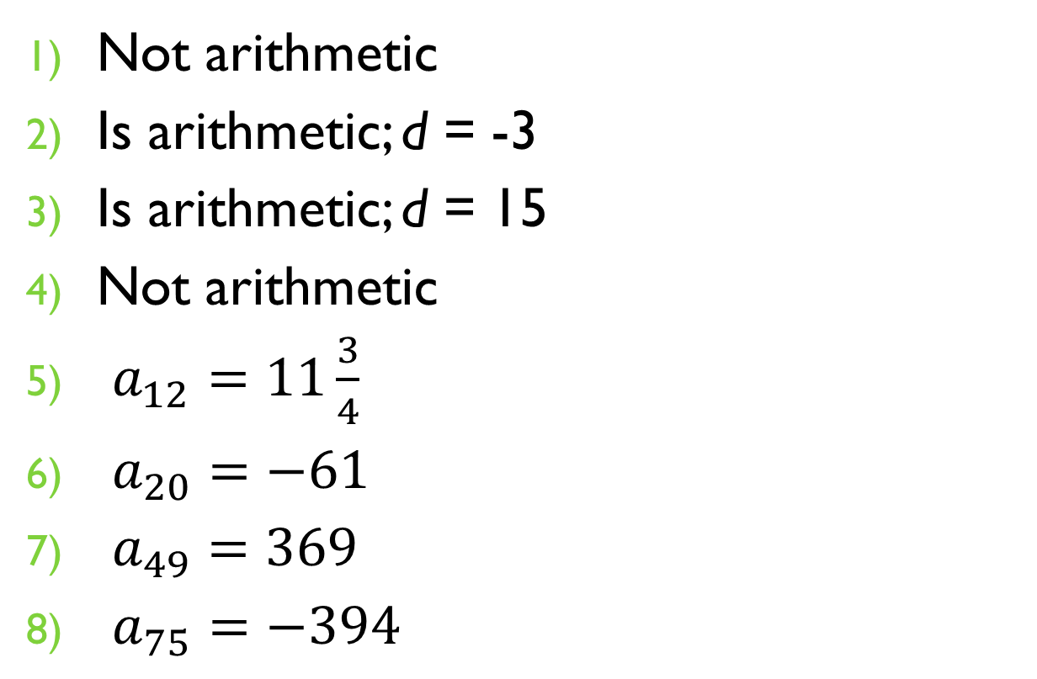
Homework Check
Not arithmetic
Is arithmetic; d = -3
Is arithmetic; d = 15
Not arithmetic
$a_{12}=11\frac{3}{4}$
$a_{20}=−61$
$a_{49}=369$
$a_{75}=−394$

Slide 3
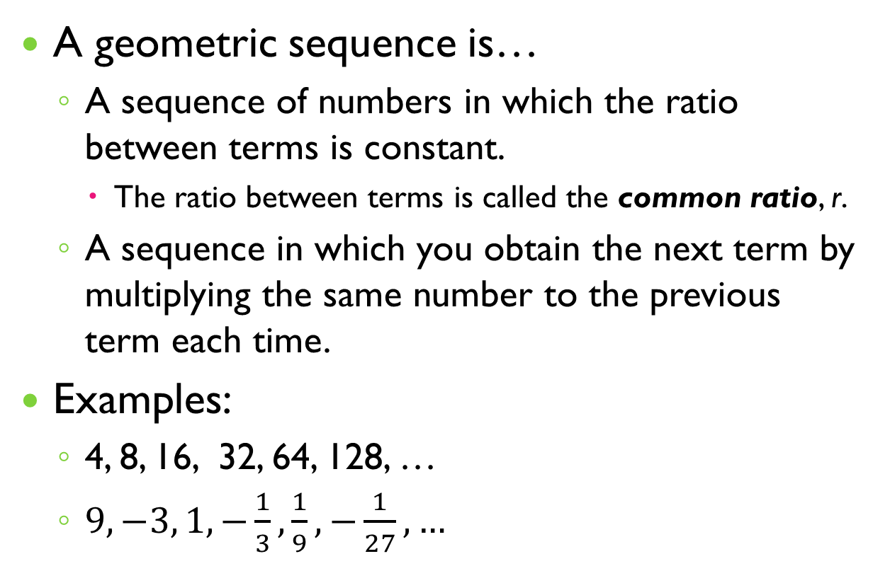
§12-2 Geometric Sequences
A geometric sequence is…
A sequence of numbers in which the ratio between terms is constant.
The ratio between terms is called the common ratio, r.
A sequence in which you obtain the next term by multiplying the same number to the previous term each time.
Examples:
4, 8, 16, 32, 64, 128, …
$9, −3, 1, −\frac{1}{3},\frac{1}{9}, −\frac{1}{27},…$

Slide 4
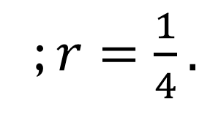


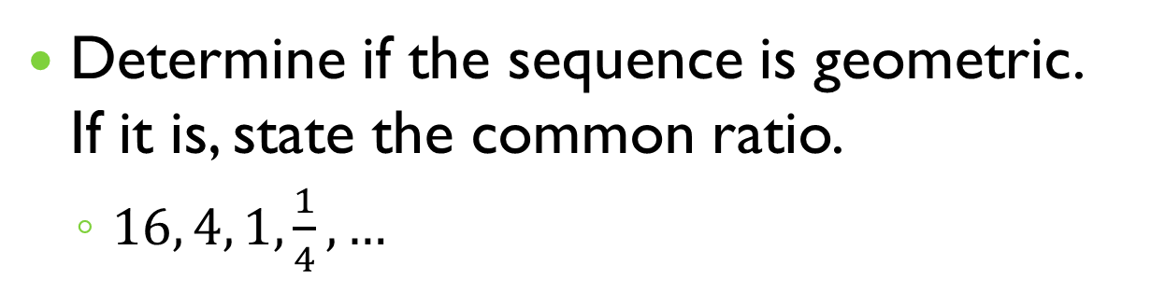



§12-2 Geometric Sequences
Determine if the sequence is geometric. If it is, state the common ratio.
$16, 4, 1,\frac{1}{4},…$
$$\frac{1}{4}$$
$$\frac{1}{4}$$
$$\frac{\frac{1}{4}}{1}$$
$$\frac{4}{16}$$
$$\frac{1}{4}$$
Yes, it’s geometric.
; $r=\frac{1}{4}.$

Slide 5



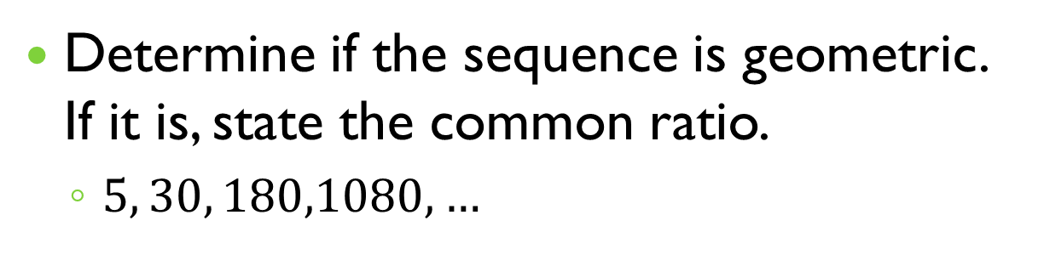

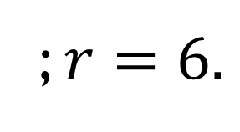


§12-2 Geometric Sequences
Determine if the sequence is geometric. If it is, state the common ratio.
$5, 30, 180,1080,…$
$$6$$
$$6$$
$$6$$
$$\frac{30}{5}$$
$$\frac{180}{30}$$
$$\frac{1080}{180}$$
Yes, it’s geometric.
; $r=6.$

Slide 6





§12-2 Geometric Sequences
Determine if the sequence is geometric. If it is, state the common ratio.
$7, 14, 21,28,…$
$$\frac{14}{7}$$
$$2$$
$$\frac{21}{14}$$
$$\frac{3}{2}$$
No, it’s not geometric.

Slide 7
§12-2 Geometric Sequences
Just like arithmetic sequences, once you know a little information about a sequence, you can determine a formula for a sequence.
Then, you can use that formula to find any term of the sequence you’re interested in.
Example:
Use the sequence: 9, 18, 36, 72, 144, …
What is the 10th term of the sequence?
We don’t want to have to list out all the terms do we?
So let’s find a shorter way by doing a bit of thinking.

Slide 8
§12-2 Geometric Sequences
Example:
Use the sequence: 9, 18, 36, 72, 144, …
What is the 10th term of the sequence?
Every time we get a new term, how much are we multiplying by? (What is the common ratio?)
2
So, to get the 3rd term, how many 2s did we multiply by?
9, 18, 36….
To get the 3rd term we multiplied by 2 2s.
So how many 2s do you think we will need to add to get the 10th term?
9 is correct!
2
2

Slide 9

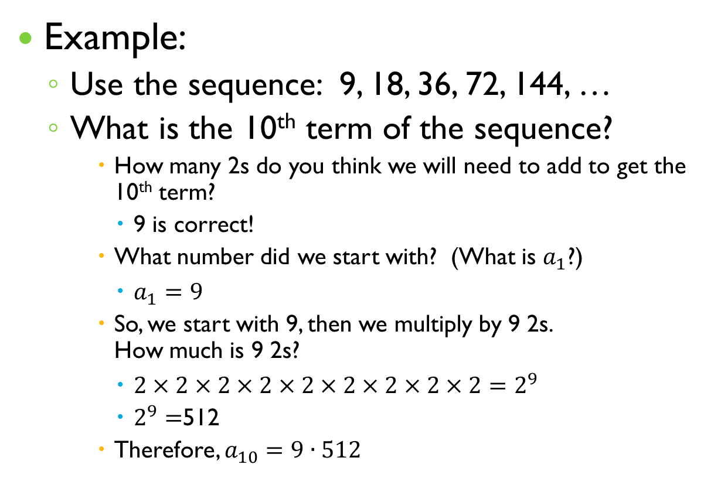
§12-2 Geometric Sequences
Example:
Use the sequence: 9, 18, 36, 72, 144, …
What is the 10th term of the sequence?
How many 2s do you think we will need to add to get the 10th term?
9 is correct!
What number did we start with? (What is $a_{1}$?)
$a_{1}=9$
So, we start with 9, then we multiply by 9 2s. How much is 9 2s?
$2×2×2×2×2×2×2×2×2=2^{9}$
$2^{9}=$512
Therefore, $a_{10}=9∙512$
$=4,608$ .

Slide 10
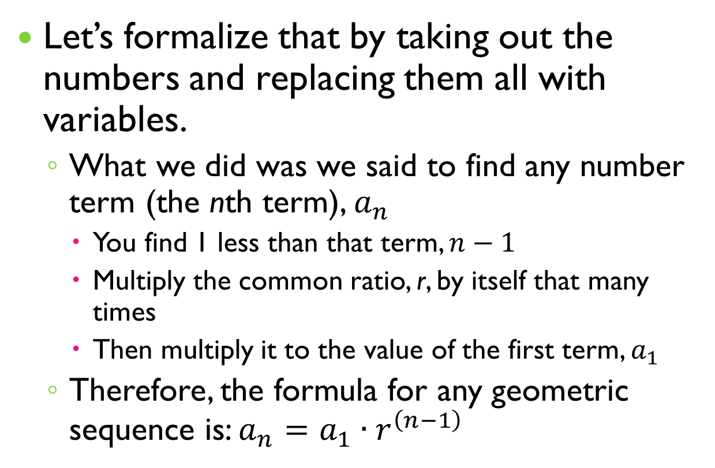
§12-2 Geometric Sequences
Let’s formalize that by taking out the numbers and replacing them all with variables.
What we did was we said to find any number term (the nth term), $a_{n}$
You find 1 less than that term, $n−1$
Multiply the common ratio, r, by itself that many times
Then multiply it to the value of the first term, $a_{1}$
Therefore, the formula for any geometric sequence is: $a_{n}=a_{1}∙r^{\left(n−1\right)}$

Slide 11
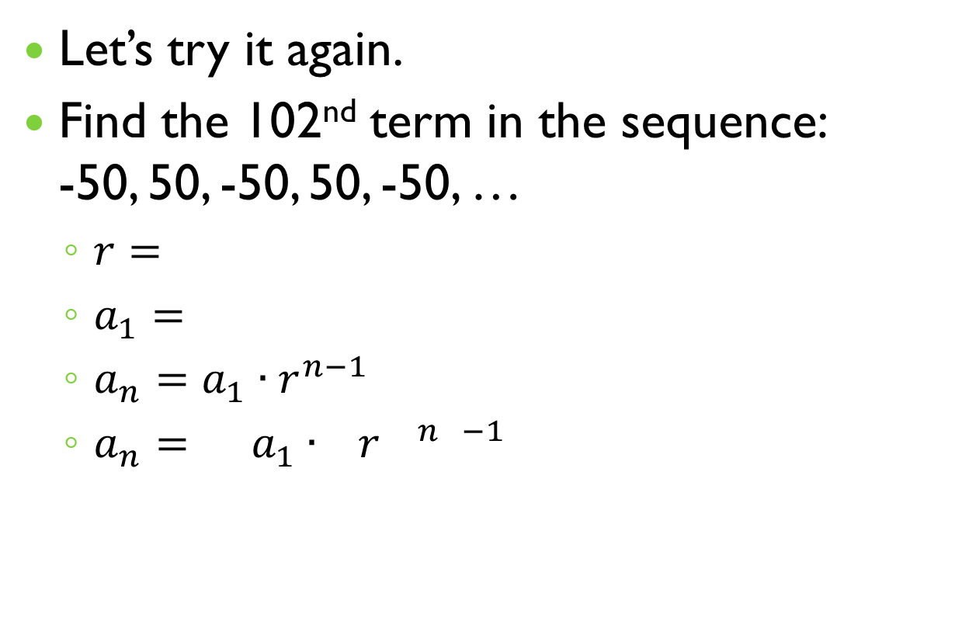
§12-2 Geometric Sequences
Let’s try it again.
Find the 102nd term in the sequence: -50, 50, -50, 50, -50, …
$r=$
$a_{1}=$
$a_{n}=a_{1}∙r^{n−1}$
$a_{n}= a_{1}∙ { r}^{ n −1}$
-1
-1
-50
-50
( )
102
102
$a_{ 102}=−50∙{\left(−1\right)}^{101}$
$a_{ 102}=−50∙(−1)$
$a_{ 102}=50$

